Slide 1
Marketing Research and Analytics
Group Assignment-Group 13, Pune
October 2017

Slide 2
Contents
Problem description
Exploratory data analysis
Menu analysis
Price analysis
Recommendations
Summary

Slide 3
Problem description
Problem statement: Provide a set of recommendations to increase revenue of a Café chain
Available: POS data for one restaurant of the chain
Required:
Exploratory data analysis for (i) anlayzing trends of consumer behaviour over different times of the day and different days of the week, and to provide concrete recommendations based on the same, (ii) identify and recommend whether certain menu items that can be taken off the menu, and (iii) identify and provide recommendations based on the observed trends across months
Menu analysis: Identify and recommend best combo meals by carrying out a thorough menu analysis
Price analysis : (i) identify pricing changes and the impact (positive or negative) on the sale of menu items

Slide 4
Data description
POS data available: one year data from April 1, 2010 to March 31,2011
Variables: Date, Time of Sale, Bill No, Item Description, Quantity, Rate, Tax, Discount, Total & Category
Day of week is estimated from data available and added to the table
Categories and Sub-categories (given as Item Description)
S. No | Category | # of Unique Sub-Categories (Item Description)
1 | Beverage | 119
2 | Food | 107
3 | Liquor | 34
4 | Liquor and Tobacco | 4
5 | Merchandise | 87
6 | Miscellaneous | 48
7 | Tobacco | 52
8 | Wines | 50

Slide 5
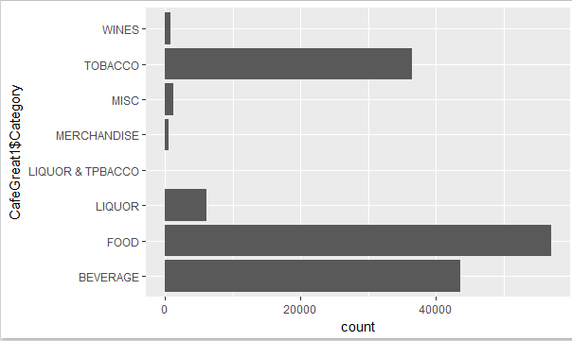
Exploratory data analysis- Annual data at a glance
Total revenue INR 3,28,05,895
Total quantity sold 163519 units
Average revenue/month INR 27,33,825
Average revenue/week INR 6,30,883
Average revenue/day INR 89,879
Best day on 31st Dec 2010, with 834 menu items served & INR 249995 as revenue

Slide 6
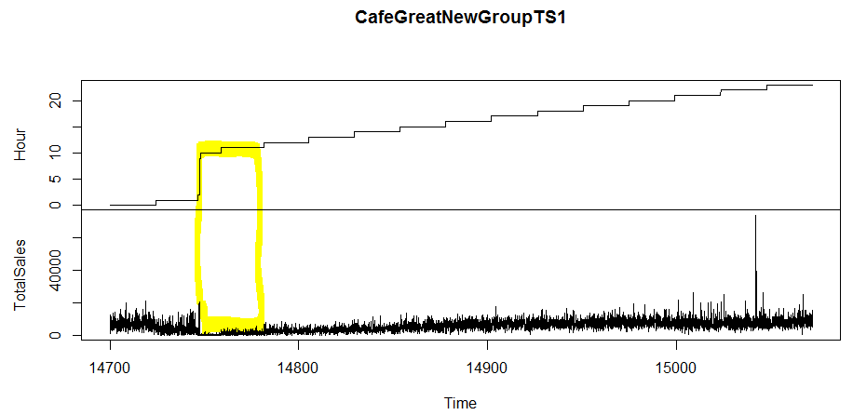
Exploratory data analysis- time of day
Sales is good between 12:00 PM and 01:00 AM (for the whole year) . Increasing trend is observed as the day progress.
Very less or no sales between 02:00 AM and 10 AM
Ccomparatively less sales between 11:00 AM and 12:00 PM

Slide 7
Exploratory data analysis- time of day (continued)
Top 3 (Revenue): Tobacco > Food > Beverage
Top 3 (Volume): Food > Beverage > Tobacco
Sales in all categories are flat or very less between 2:00 AM and 10:00 AM
Food sales start increasing from 10:00 AM
Sales is good between 11:00 AM and 01:00 AM

Slide 8
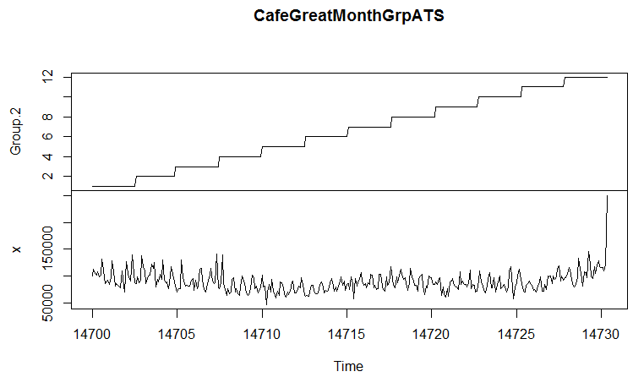
Exploratory data analysis- trend by month
Group.2 represents Month ,X represents Total Sales and Time represents the spread of sales across month
Best months of the year for revenue (December & January)
December revenue (for the whole year) : INR 34,73,691

Slide 9
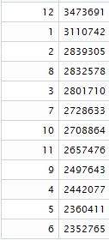
Exploratory data analysis- trend by month(continued)
Top 3 (Revenue): Tobacco > Food > Beverage
Top 3 (Volume): Food > Beverage > Tobacco
High periods of sales: July-August and December-March (highest for the year) coinciding with vacation and festival time
December and January is the highest revenue earning month
Revenue earned month wise in decreasing order ->

Slide 10
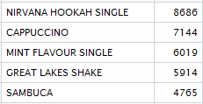
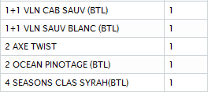
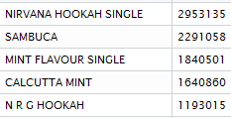
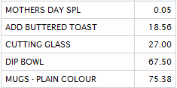
Exploratory data analysis- yearly data
Top 5 Item Sold(Item Name, Quantity)
Bottom 5 Item Sold(Item Name, Quantity)
Top 5 Item Sold(Item Name, Revenue)
Bottom 5 Item Sold(Item Name, Revenue)
Nirvana Hookah Single and Cappuccino is the most popular item (Maximum Quantity Sold), and most popular food item is Poutine with Fries
Nirvana Hookah Single is the most popular item on the menu (Considering Quantity Sold and Revenue earned)
The most popular beverage throughout the day is Cappuccino (It does not figure into top 5 considering revenue earned)
Sambuca appears to be the second most revenue earning item after Nirvana Hookah Single

Slide 11
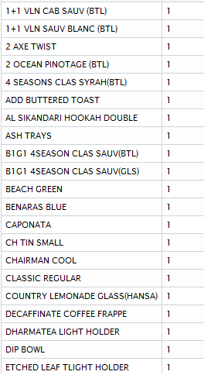
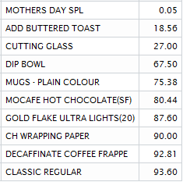
Items that can be taken off from menu
Generally maintaining inventory of any item is an expense, therefore it makes sense to remove items that don’t sell from the menu
We consider revenue generated by every item, and assume that every item is sold at a profit
Based on yearly data, we look into bottom 10/20 items which has been sold in less quantity or earned less revenue .
Care should be taken before removing some items completely from the menu as they can be offered only on special occasions ( like Mothers Day Special ) or flavouring add on’s .
Sold Only Once (Only few items are shown as there are few more items
which has been sold once)-
Top 10 items which generated less revenue -

Slide 12
Items that can be taken off menu (continued)
Items can be kept only for special occasion or for adding flavour – Mothers Day Spl, Add Buttered Toast
Items can be taken off from menu :
Cutting Glass , Dip Bowl , Mugs – Plain Colour , Mocafe Hot Chocolate(SF) , Gold Flake Ultra Lights ,
CH Wrapping Paper , Decaffinate Coffee Frappe , Classic Regular , 1+1 VLN CAB SAUV (BTL) ,
1+1 VLN SAUV BLANC (BTL) , Big One 4Season Clas Sauv (BTL) , Big One 4Season Clas Sauv (GLS) ,
Beach Green, Benaras Blue, Caponata , CH Tin Small , Chairman Cool

Slide 13
Menu analysis-market basket analysis
Objective: To identify which menu items were brought together by the customers so that appropriate combo meals can be designed to increase the revenues of the Café chain
Methodology followed
To analyse in R, load library(arules) and library(splitstackshape)
Segregate menu items into a separate data frame
Association Rules: Identify product association and plot scatter plot chart for association
Checked support and lift for the product combinations
Select associations
Summarize results and recommended combo meals

Slide 14
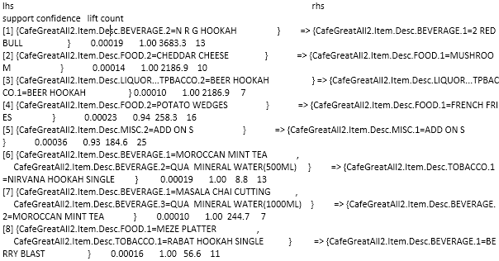
Menu analysis-association rules
Use the apriori function to identify association rules
Identified 8 rules based on support level - .0001 and confidence level - .9 .
Analysis of Rule # 1 enables prediction with 100% confidence and based on .00019 support that if a customer orders NRG HOOKAH, then that customer will also order 2 RED BULL
Same interpretation for rest of the 7 rules
Values of Confidence for all groups are 1 and therefore can be considered as good rules to make predictions on buying patterns

Slide 15
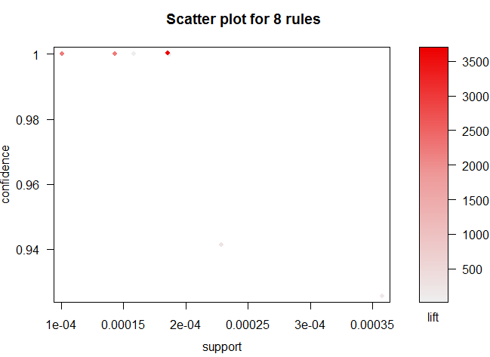
Menu analysis-scatter plot chart for association rules

Slide 16
Menu analysis- Combination deals for the menu
Combo Deal # | Description
1 | N R G HOOKAH+ 2 Red Bull
2 | Cheddar cheese+ Mushroom
3 | Potato Wedges + French Fries
4 | Moroccan Mini Tea + Qua Mineral Water (500 ml) + Nirvana Hookah Single
Therefore, from Market Basket Analysis ,we have the above Food and Beverage combinations, with all rules having a confidence level of ≥ 0.75 and lift >1
Inclusion of the above combinations as Combo items in the menu is highly recommended
A detailed calculation in R on market basket analysis and rest of the assignment is provided in the attached document separately

Slide 17
Price Change Analysis
There are lot of items with price change. We’ve considered only those whose prices have not changed within a month . After filtering in this way also we got lot of items which was difficult to plot in a single graph . So, we’ve sampled few items and plotted those .
In next two slides two analysis are plotted.
One of them shows that when Rate of the item decreases then Volume of sales increases and which in turn increases revenue .
Another plot shows that for an item sales decreases after reduction in price after a certain rate .

Slide 18
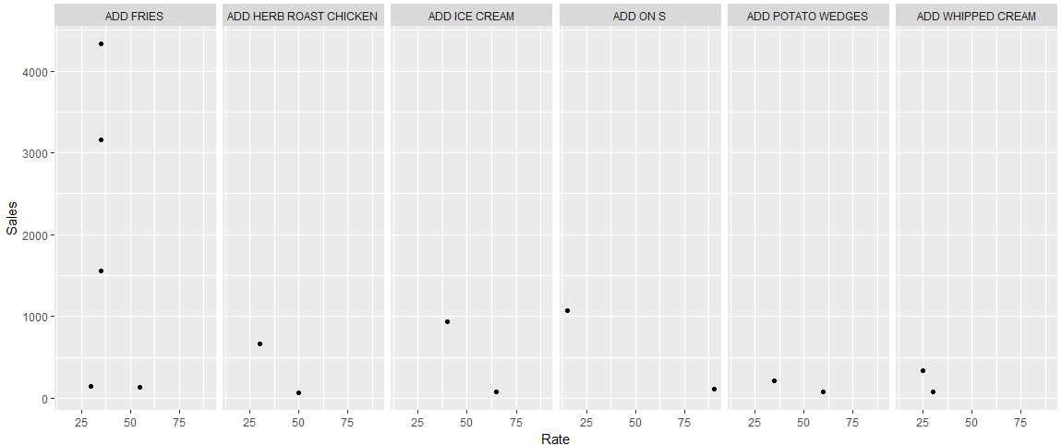
Price Analysis Plot (Volume of Sales increases when Price rate decreases)

Slide 19
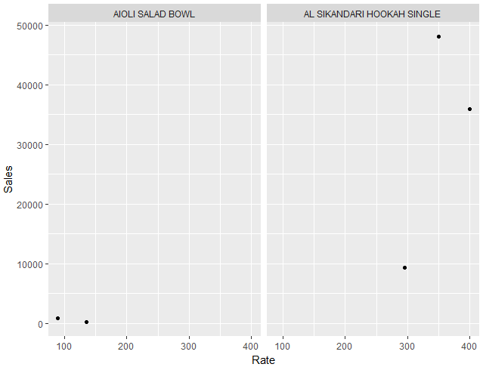
Price Analysis Plot (Volume of Sales decreases when Rate decreases after certain amount for Al Sikandari Hookah Single )

Slide 20

Thank You

